Slide 1
AWS IAM
MPRASHANT
AWS Identity & Access Management

Slide 2
IAM is a service that helps you securely control access to AWS resources.
MPRASHANT
It allows you to manage users, roles, and permissions to define who can access what within your AWS environment.

Slide 3








MPRASHANT
root

Slide 4

Free Service: IAM is offered at no additional cost Global Service
Root account created by default, shouldn’t be used or shared
MPRASHANT

Slide 5

Create Users: You can create individual user accounts for people who need access to your AWS resources.
MPRASHANT
Assign Permissions: You can assign specific permissions to users, groups, or roles to control what actions they can perform on AWS services.
Create Groups: You can group users together and assign permissions to the group, making management easier for multiple users.

Slide 6
















Group
Users
paul
paul
alex
operations
alex

Slide 7

Create Roles: You can create roles to assign temporary permissions to AWS services or users, especially useful for securely managing permissions across different AWS resources.
MPRASHANT
Define Policies: You can create and attach custom policies to define fine- grained permissions for controlling access to AWS resources.
Manage Federated Access: IAM allows integrating with external identity providers (like Active Directory) for centralized management of user access across AWS.

Slide 8
AWS IAM
MPRASHANT
MFA
MFA (Multi-Factor Authentication) is an extra layer of security that requires users to provide two or more forms of verification, like a password and a code from their phone, to access their accounts.

Slide 9
AWS IAM
MPRASHANT
MFA
username + password + security code

Slide 10
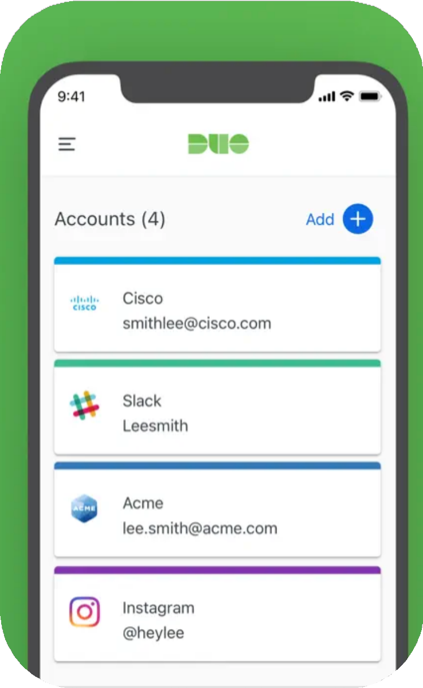
DUO Mobile

Slide 11
MPRASHANT
AWS IAM
Ways of accessing AWS

Slide 12


The AWS Management Console provides a graphical, web- based approach.
MPRASHANT
The AWS CLI provides a command-line, scripting approach.
AWS SDKs and APIs offer programmatic, code-based access, allowing users to integrate AWS directly into their applications.

Slide 13

AWS IAM Best Practices
MPRASHANT
Avoid using root account except of account setup. Add user to a group and assign permission to group Use password policy or MFA
Use ACCESS KEYS for CLI/SDK
Never share ACCESS KEYS or Password
Audit the permission using IAM credential report.

